Slide 1
INVESTMENT ASSIGNMENT SUBMISSION
Name:

Slide 2
ABSTRACT
Spark Funds LLC is planning to start investment in companies. Analysis is required to understand global market trend in for efficient and effective investment. Main objective of analysis is to find most prominent investment type, countries and sectors to invest i.e. where majority of investment in the world is going to.The company has some constraints regarding that must be adhere to during analysis.

Slide 3
METHODOLOGY
Analysis based on the Investment types.
Analysis based on Countries
Analysis based on Sector

Slide 4
ANALYSIS
ANALYSIS BASED ON INVESTMENT TYPE
Identification of investment type which is receiving the maximum number of investments and is within the budget of the company.
The main investment type the company is interested are – Seed, Angel, Venture and Private Equity and the budget is between 5 and 15 million.
ANALYSIS BASED ON COUNTRIES
Identification of countries that are receiving the maximum amount of investment for the selected investment type and selecting top 9 from those countries.
Identifying top 3 countries from the selected above where either English is one of the official language.

Slide 5
ANALYSIS
ANALYSIS BASED ON SECTORS
Identification of sectors in the top 3 countries selected before which received the maximum amount of investment.
Selection of top 3 sectors for each country.

Slide 6
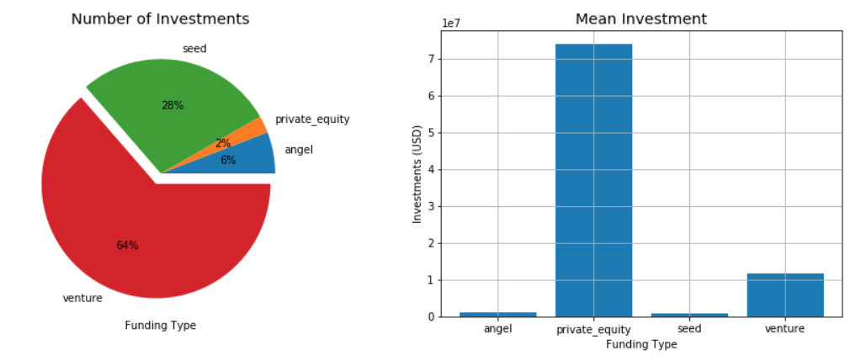
ANALYSIS BASED ON INVESTMENT TYPES

Slide 7
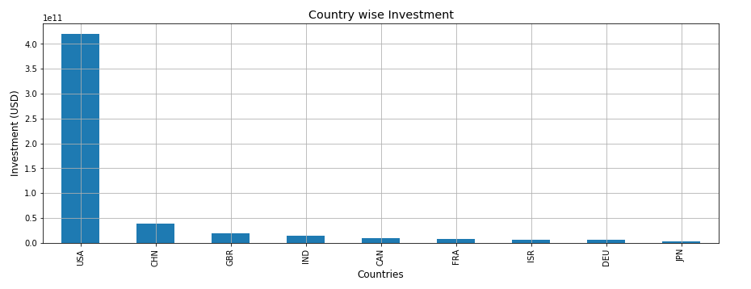
ANALYSIS BASED ON COUNTRIES

Slide 8
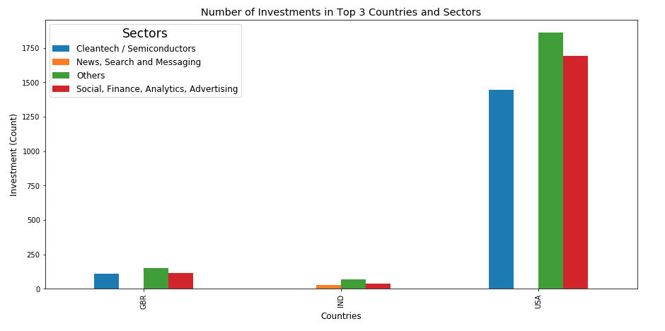
ANALYSIS BASED ON SECTORS

Slide 9
CONCLUSION
Based on analysis and graphs, we can conclude the following points
Among the four investment types, venture is the most promising investment type for the company to invest. The average investment falls under the company’s budget (11.7 mil) and has the most number of investments in the past.
Top English speaking country that has been target of most of investors is USA.
In USA, the most famous sector to invest is Others.

